Slide 1

Engineering Analysis and Design (MODELLING AND SIMULATION) COURSE CODE: CO-207 UNIT-3
DELHI TECHNOLOGICAL UNIVERSITY, NEW DELHI
DEPARTMENT OF COMPUTER SCIENCE AND ENGINEERING

Slide 2
Syllabus – Unit:3
UNIT-3 : SIMULATION SOFTWARE
Modelling of Complex Systems
Use of a Simulation Language such as GPSS, SIMSCRIPT, SLAM, GASP, and SIMULA.
COURSE OUTCOME COVERED:
To construct a model for complex systems and experiment with simulation language.

Slide 3
Introduction
In this unit we will cover:
Mathematical Modelling of Complex Systems
Database
Brief of AI in Modelling and Simulation
Brief of Neural Networks in Modelling and Simulation
Simulation Languages
SIMULA
GASP
GPSS
SIMSCRIPT
SLAM

Slide 4
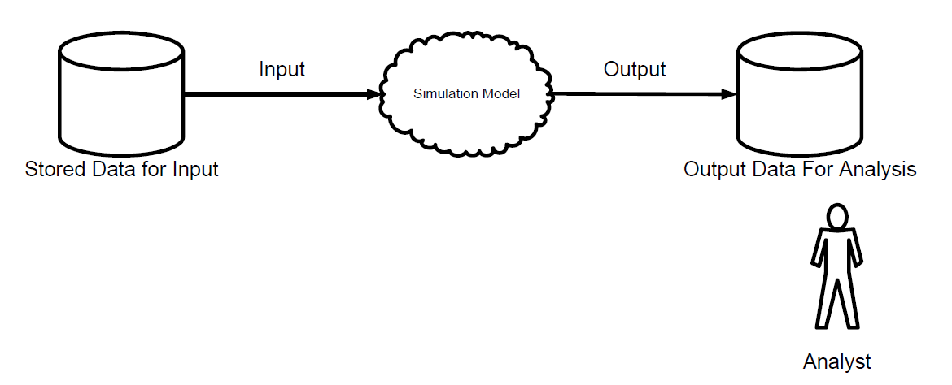
Modelling of Complex Systems
The application of Artificial Intelligence (A.I.) concepts like Fuzzy Sets to solve complex partial differential equations, and application of neural networks in modeling of complex system.
A complex system requires a large amount of input data and simultaneously produce large output data for analysis purpose.
The figure below represents the basic database concepts for simulation.

Slide 5
In the figure, the primary concepts are a simulation event, input files that may be parameterized, and output files produced by a software program.
Database is very important in modeling and simulation ,when developed model is used large number of
inputs data and produce large number of output.

Slide 6
AI in Modelling and Simulation
A.I. has an equally valuable role to play in avoiding misunderstandings between human and machine so that the two can be real partners in planning not only for efficient and safe routine operations, but also for recovering from unavoidable faults in simulation.
A.I. techniques, such as evolutionary algorithms and influence diagrams, can be used to detect kind of incremental degradation in the automated process of simulation before it rises up to bite us.
AI techniques such as procedural heuristics and constraint resolution can be used to guide the simulation in deciding when and if automatic protective devices can be overridden, in planning restart and workaround, As recovery proceeds, planning should always be working toward optimization (using evolutionary algorithms or other hill-climbing techniques), while engaging in a continual trade-off with the demands of reliable operation.

Slide 7
The design motivation is what distinguishes neural networks from other mathematical techniques: A neural network is a processing device, either an algorithm, or actual hardware, whose design was motivated by the design and functioning of human brains and components thereof.
Neural Networks offer improved performance over conventional technologies in areas which includes: Machine Vision, Robust Pattern Detection, Signal Filtering, Virtual Reality, Data Segmentation, Data Compression, Data Mining, Text Mining, Artificial Life, Adaptive Control, Optimization and Scheduling, Complex Mapping and more.
Neural networks have been applied to a wide variety of different areas including speech synthesis, pattern recognition, diagnostic problems, medical illnesses, robotic control and computer vision.

Slide 8
Application – Case Study
At Boeing Aircraft Company, researchers have been developing a neural network to identify aircraft parts that have already been designed and manufactured, in efforts to help them with the production of new parts. Given a new design, the system attempts to identify a previously designed part that resembles the new one. If one is found, it may be able to be modified to conform to the new specifications, thus saving time and money in the manufacturing process.

Slide 9
SELF- ASSESSMENT TEST
Q.1 Why we used database in Modelling and Simulation?. Explain with suitable example.
Q.2 Discuss the role of Artificial Intelligence in Modelling and Simulation.
Q.3 How Neural Network is applied in Modelling and Simulation of a complex system.

Slide 10
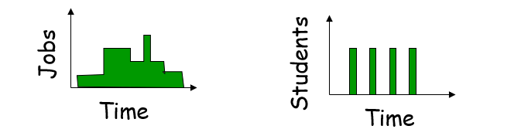
IMPORTANT TERMS
Event
A change in system state
Ex: Three events: arrival of job, beginning of new execution, departure of job
Continuous-time and discrete-time models
If state defined at all times → continuous
If state defined only at instants → discrete
Ex: class that meets M-F 2-3 is discrete since not defined other times

Slide 11
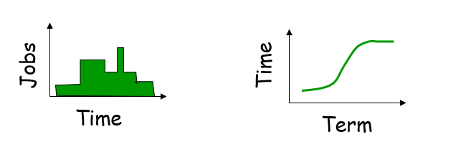
Continuous-state and discrete-state models
If uncountably infinite → continuous
Ex: time spent by students on hw
If countable → discrete
Ex: jobs in CPU queue
Note, continuous time does not necessarily imply continuous state and vice-versa
All combinations possible

Slide 12
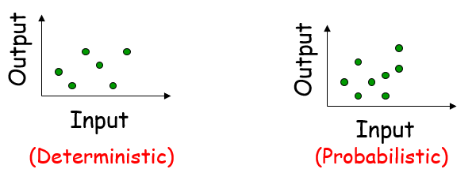
Deterministic and probabilistic models
If output predicted with certainty → deterministic
If output different for different repetitions → probabilistic
Ex: For proj1, dog type-1 makes simulation deterministic but dog type-2 makes simulation probabilistic

Slide 13
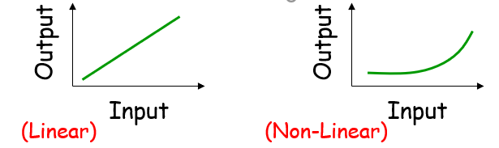
Static and dynamic models
Time is not a variable → static
If changes with time → dynamic
Ex: CPU scheduler is dynamic, while matter-to-energy model E=mc² is static
Linear and nonlinear models
Output is linear combination of input → linear
Otherwise → nonlinear

Slide 14
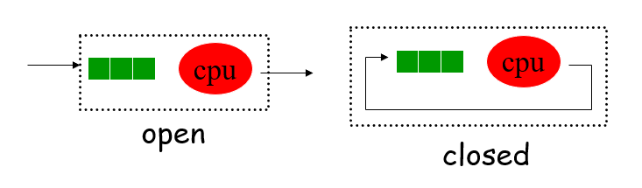
Open and closed models
Input is external and independent → open
Closed model has no external input
Ex: if same jobs leave and re-enter queue then closed, while if new jobs enter system then open

Slide 15
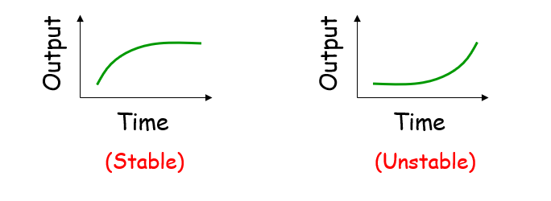
Stable and unstable
Model output settles down → stable
Model output always changes → unstable

Slide 16
Selecting a Simulation Language
Four choices: simulation language, general-purpose language, extension of general purpose, simulation package
Simulation language – built in facilities for time steps, event scheduling, data collection, reporting
General-purpose – known to developer, available on more systems, flexible
The major difference is the cost tradeoff – simulation language requires startup time to learn, while general purpose may require more time to add simulation flexibility
Recommendation may be for all analysts to learn one simulation language so understand those “costs” and can compare

Slide 17
Extension of general-purpose – collection of routines and tasks commonly used. Often, base language with extra libraries that can be called
Simulation packages – allow definition of model in interactive fashion. Get results in one day
Tradeoff is in flexibility, where packages can only do what developer envisioned, but if that is what is needed then is quicker to do so

Slide 18
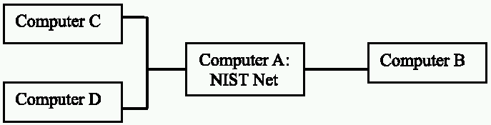
TYPES OF SIMULATION
Variety of types, but main: emulation, Monte Carlo, trace driven, and discrete-event
Emulation
Simulation that runs on a computer to make it appear to be something else
Examples: JVM, NIST Net
Java program
Java VM
Process
Process
Operating System
Hardware

Slide 19
Outline of Simulation Languages
Simulation Languages
Continuous Simulation Languages
Block Oriented Simulation Languages
Expression Oriented Simulation Languages
Discrete Simulation Languages
Activity Oriented Language
Event Oriented Language
Flowchart Oriented Language
Process Oriented Language

Slide 20
Simulation Languages
Continuous Simulation Languages
Discrete Simulation Languages
Flowchart-Oriented Languages
Activity-Oriented Languages
Block-Oriented Simulation Languages
Expression-Oriented
Simulation Languages
Event-Oriented Languages
Process-Oriented
Languages

Slide 21
SELF-ASSESSMENT QUESTIONS
Q.1 What is the Simulation language? Discuss the different kinds of simulation language.
Q.2 Flow chart simulation language comes in which category? Give an example of it.
Q.3 Describe the discrete and continuous simulation language with one daily life example.

Slide 22
SIMULA
The first Object Oriented Language (OOL) Simula 67 was officially introduced by Ole Johan Dahl and Kristen Nygaard at the IFIP TC 2 Working Conference on Simulation Languages in Lysebu near Oslo in May 1967.
SIMULA program is made up of sequences of instructions known as blocks, which act independently to varying degrees, but which are combined to produce the desired overall effect.
The simplest programs contain only one block, known as the program block.
SIMULA is NOT a case sensitive language.
Instructions in the SIMULA are of two types: DECLARATIONS and STATEMENTS.
Every executable statements in SIMULA end with a semicolon.

Slide 23
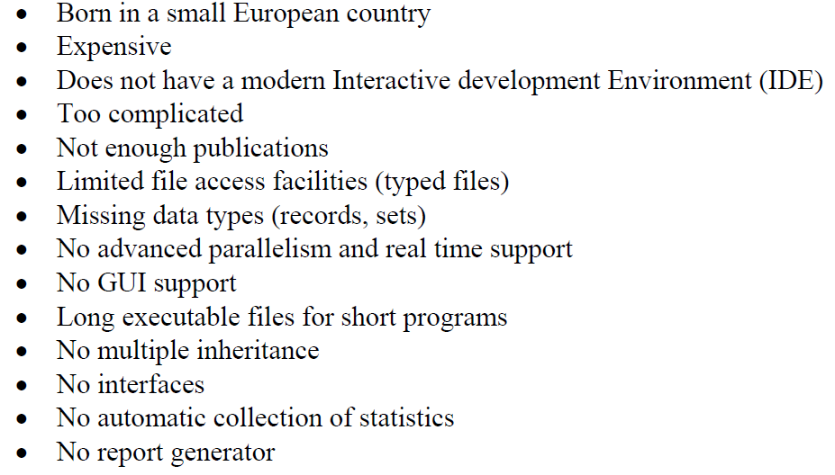
Disadvantages of SIMULA

Slide 24
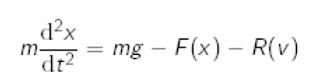
TRY TO SIMULATE: BUNGEE JUMPING MODEL
A bungee jumper jumps from 240 ft above the ground. The length of the unstretched bungee cord is 90 feet. The differential equation of motion is :
where F(x) = kx is the force on the jumper exerted by the bungee cord, and R(v) = cv is air resistance with velocity v. Notice that v = x0(t). A cord we plan to use has k = 2.5 pounds per foot. Is this cord good enough?
Simulate the Bungee Jumping Model in a suitable language and analysis the results.

